Slide 1

Modernisez la haute disponibilité de votre MySQL
Webinar du 7 Octobre 2025
Emmanuel COLUSSI
MySQL Solution Architect EMEA
Oracle MySQL GBU

Slide 2


Emmanuel COLUSSI
Architecte Solutions MySQL chez Oracle
25 ans d’expérience dans la conception et la mise en œuvre de solutions complexes et hautement disponibles, dans des secteurs tels que la santé, les télécommunications, l’assurance, la finance et la défense.
Spécialisé dans les architectures cloud-native, les déploiements sur Kubernetes, et passionné par la programmation en Go.
📂 Mes webinars sur GitHub ::: https://github.com/colussim/webinar
🤝 Restons en contact :
https://www.linkedin.com/in/emmanuel-colussi-b8b29113/

Slide 3
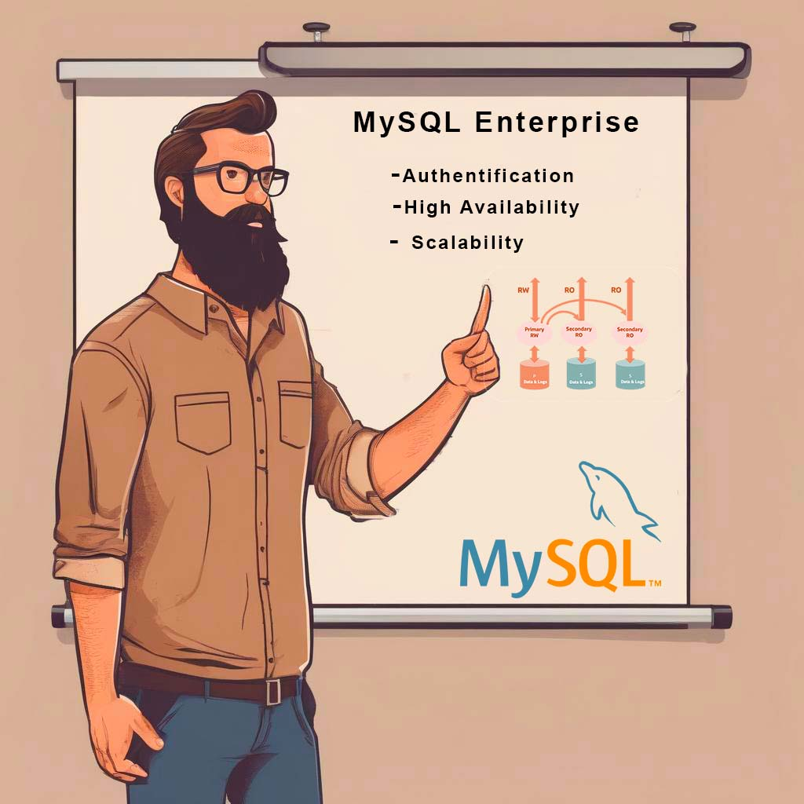
Agenda
👉 MySQL Enterprise Edition
👉 Building Blocks InnoDB Cluster
👉 Architecture InnoDB Cluster
👉 Topology
👉 Demo

Slide 4


Questions ?

Slide 5


Slide 6
MySQL Enterprise Edition
The different versions

Slide 7






MySQL Community VS MySQL Enterprise
1
2
3
MySQL Security
MySQL Scalability
MySQL HA DR
4
5
6
MySQL Stored Programs
MySQL Monitoring
MySQL 24x7
Support
MySQL Community

Slide 8
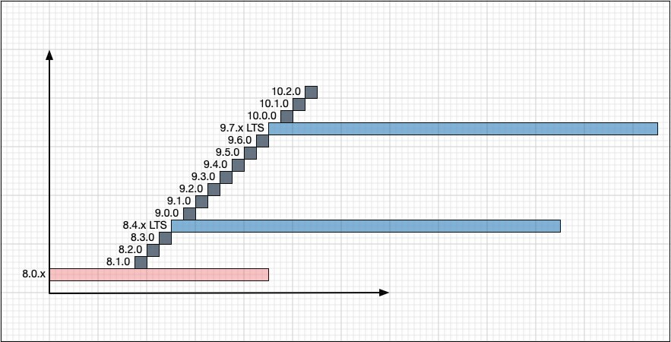
NEW: MySQL LTS & Innovation Releases
MySQL Community and Enterprise
Innovation releases (grey)
Long Term Support (blue)
Note: Numbering in the slide is an example and may change
MySQL Long-Term Support (LTS) Releases
bugfix & security patches only
backwards compatibility
support lifecycle: 5y premier + 3y extended
Include tools (like MySQL Shell)
MySQL Innovation Releases
leading-edge innovations
will likely released every quarter
Include tools (like MySQL Shell)
Connectors released as Innovation only

Slide 9


Slide 10


Slide 11
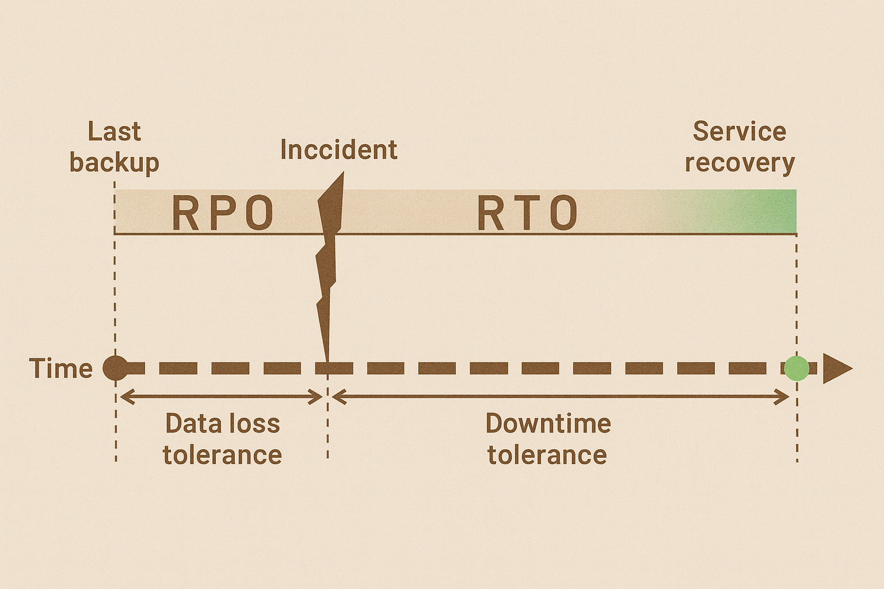

Building Blocks of MySQL InnoDB Cluster
MySQL Instances
Concepts – RTO & RPO
✅ Recovery Time Objective (RTO)
- Total time required to complete a repair and reconnect a system.
✅ Recovery Point Objective (RPO).
The point in time to which you need to recover data. This represents the window of data loss.
Types d'échec
High Availability: Single server failure, network partition.
Disaster Recovery: Total region/network outage
Human Error: Errors DBA, SQL Injection , ...

Slide 12
MySQL InnoDB Cluster
Building Blocks

Slide 13


Building Blocks of MySQL InnoDB Cluster
1
2
3
4
5
MySQL Instances
Instances that make up the cluster.
InnoDB
The main storage engine that provides transactional capabilities.
Group Replication
A synchronous replication mechanism ensuring data consistency between instances.
MySQL Shell
Tool for managing and configuring the cluster.
MySQL Router
Middleware for routing queries to the appropriate instances.

Slide 14
Building Blocks of MySQL InnoDB Cluster
MySQL Instances
1
✅ Minimum number of instances: You need at least 3 instances to ensure effective resilience and fault tolerance. This allows for achieving a majority during decision processes (like leader election).
✅ Maximum number of instances: While there is no strict limit defined by MySQL, common practice recommends not exceeding 9 instances in a cluster to avoid complexities and performance issues. Generally, an odd number of instances is preferable to facilitate decision-making in case of failure.
MySQL Instances
Instances that make up the cluster.

Slide 15
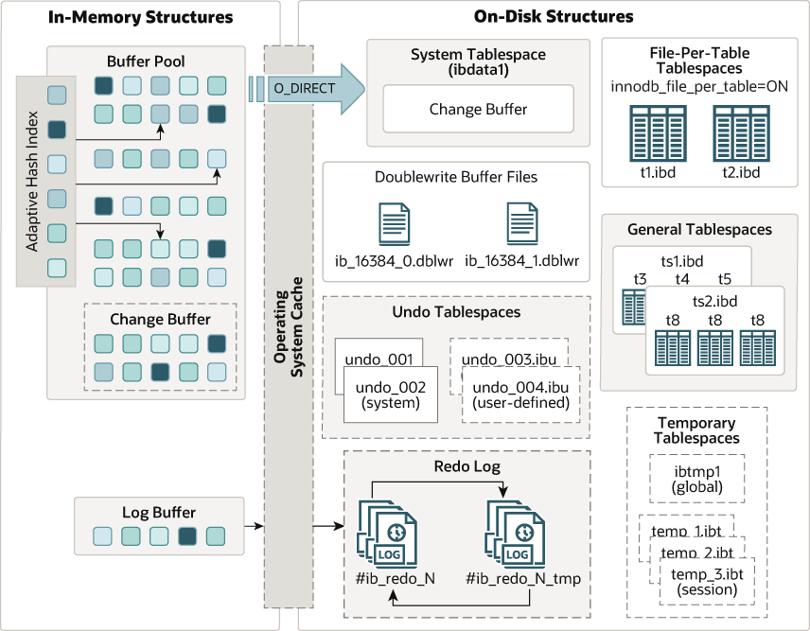
Building Blocks of MySQL InnoDB
InnoDB
2
MySQL InnoDB is a storage engine integrated into MySQL that offers several key features, making MySQL suitable for a variety of applications, particularly those requiring advanced transaction management.
InnoDB
The main storage engine that provides transactional capabilities.

Slide 16
Building Blocks of MySQL InnoDB
InnoDB : main characteristics
✅ ACID Transactions: InnoDB supports ACID properties (Atomicity, Consistency, Isolation, Durability), ensuring that transactions are processed reliably.
✅ Row-Level Locking: InnoDB uses a row-level locking mechanism, allowing for more efficient concurrent access to the database. This reduces conflicts and improves performance in high-traffic environments.
✅ Crash Recovery: It has a recovery log that allows the database to restore its state in the event of a failure or unexpected shutdown.
✅ Foreign Key Support: InnoDB includes support for referential integrity constraints, allowing relationships between tables to be defined through foreign keys.
✅ Performance: It uses a buffer pool-based architecture for caching, which improves the performance of input/output (I/O) operations and optimizes read and write performance.
✅ Compressed Tables: InnoDB allows for table compression, which can reduce the storage space required while maintaining good performance.
✅ Partitioning: It also supports table partitioning, allowing data to be divided into segments that can be managed independently, improving performance and management.
2
InnoDB
The main storage engine that provides transactional capabilities.

Slide 17


Building Blocks of MySQL InnoDB Cluster
Group Replication
MySQL Group Replication is a built-in feature in MySQL that enables the creation of highly available and fault-tolerant MySQL database clusters.
It allows multiple MySQL servers to work together as a single group, where changes made to one server are automatically propagated to all other servers in the group.
3
Group Replication
A synchronous replication mechanism ensuring data consistency between instances.
RW
RO
RO
Primary
RW
Secondary
RO
Secondary
RO
P
S
S
Data & Logs
Data & Logs
Data & Logs

Slide 18
Building Blocks of MySQL InnoDB Cluster
Group Replication : key aspects
✅ Data Consistency: Group Replication ensures that all members of the group have the same data and maintain consistency through its use of distributed transactions.
✅ High Availability: If one server goes down, the other servers in the group can continue to operate normally, improving overall availability.
✅ Automatic Failover: The system can automatically detect failure situations and promote a new primary server without manual intervention.
✅ Read and Write Scalability: It supports both read and write operations, enabling horizontal scalability as you can add more servers to the group to handle increased load.
✅ Synchronous Replication: Group Replication uses a synchronous replication mechanism, meaning changes are confirmed by a majority of the group members before being considered successful.
✅ Conflict Handling: It includes built-in mechanisms for conflict resolution, allowing for safe concurrent write operations.
3
Group Replication
A synchronous replication mechanism ensuring data consistency between instances.

Slide 19
Building Blocks of MySQL InnoDB Cluster
Group Replication : requirements
✅ InnoDB only tables
✅ Primary key is required on every table
- Invisible columns may have Primary Key/Unique Index
- Generated Invisible Primary Key mode (GIPK) automatically adds invisible columns
with PK on tables created without an explicit primary key
✅ Binary Logs active (ROW)
✅ Global Transaction Identifiers (GTID) turned on
✅ 3, 5, 7 or 9 nodes
3
Group Replication
A synchronous replication mechanism ensuring data consistency between instances.

Slide 20
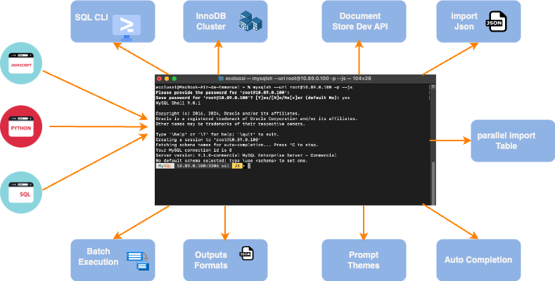
Building Blocks of MySQL InnoDB Cluster
MySQL Shell
MySQL Shell is a powerful and interactive environment for working with MySQL.
It offers several usage modes, including SQL mode, JavaScript mode, and Python mode, allowing developers and database administrators to execute scripts and queries efficiently.
4
MySQL Shell
Tool for managing and configuring the cluster.

Slide 21
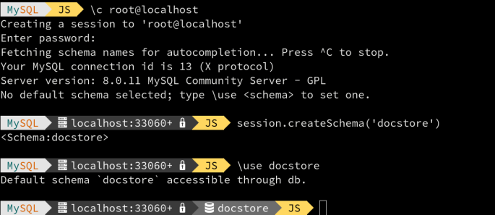
Building Blocks of MySQL InnoDB Cluster
MySQL Shell : features
✅ Multi-language Support: Ability to execute scripts in SQL, JavaScript, or Python.
This offers flexibility for developers and administrators based on their preferences.
4
✅ Automation: Allows for the automation of common database management tasks,
such as backups, recoveries, and InnoDB Cluster deployment.
✅ Integration with MySQL Server: MySQL Shell easily connects to MySQL instances,
facilitating command execution and server configuration management.
MySQL Shell
Tool for managing and configuring the cluster.
✅ Increased Productivity: Provides an interactive environment with auto-completion features.
✅ Ease of Cluster Management: Simplifies MySQL cluster management through streamlined commands.

Slide 22



Building Blocks of MySQL InnoDB Cluster
MySQL Router
MySQL Router is a lightweight software that acts as a routing layer for applications connecting to MySQL instances.
It manages the routing of connections to the appropriate backend servers in a high-availability environment.
Copy
5
application
MySQL Router
Middleware for routing queries to the appropriate instances.
MySQL Router offers 3 ports :
✅ connect to read/wtite node (6446)
✅ connect to read only node (6447) : Round robin
✅ Transparent split read/writes (6450):
- Direct all read traffic to read-only instances, and all write
traffic to read-write instances
- Each client session can communicate with one read_write and
one read_only destination
MySQL Router
RO
RO
R/W
primary
secondary
secondary

Slide 23

Building Blocks of MySQL InnoDB Cluster
MySQL Router : deployment scenarios
One per application server
Pro
minimal overhead
No network hop between application and database
easy deploy of new Routers
CONS
firewall between layers requires a rule for each application server
3rd party cluster on dedicated servers
Pro
no single point of failure
easy configuration with firewalls
CONS
required 3rd party software
required an additional hop on the network
Dedicated servers + connectors bult-in HA
Pro
No need of 3rd party sw or VIP
CONS
Not all connectors have built-in HA capabilities
required an additional hop on the network
DNS/SRV
PRO
a single DNS domain can map to multiple targets (servers)
CONS
Requires 3rd party SW
Requires connectors that support it
Service Discovery Tool
(Consul, etcd, K8s…)
APP
APP
APP
APP
APP
APP
Conn
Conn
APP
APP
Router
Router
3rd party HA sw + VIP
Router
Router
Router
Router
Router
InnoDB Cluster
InnoDB Cluster
InnoDB Cluster
InnoDB Cluster

Slide 24
MySQL InnoDB Cluster
Topologies

Slide 25
InnoDB Cluster
Topologies
RW
RO
RO
RW
RW
RW
Primary
RW
Secondary
RO
Secondary
RO
Primary
RW
Primary
RW
Primary
RW
P
S
S
P
P
P
Data & Logs
Data & Logs
Data & Logs
Data & Logs
Data & Logs
Data & Logs
Single primary node topology by default
- 3, 5, 7, or 9 nodes
- The cluster remains resilient after 1, 2, 3, or
4 failures, respectively.
Multi-Primary Topology
All nodes are read/write

Slide 26
InnoDB Cluster
Topologies
RW
RO
RO
RO
Fast Network
Primary
RW
Secondary
RO
Secondary
RO
Secondary
RO
P
S
S
S
Data & Logs
Data & Logs
Data & Logs
Data & Logs
Single primary node topology by default
- 3, 5, 7, or 9 nodes
- The cluster remains resilient after 1, 2, 3, or
4 failures, respectively.

Slide 27
InnoDB Cluster
Topologies : ClusterSet
application
application
application
LONDON
GENEVA
MILAN
Async
Replication
Async
Replication
MySQL Router
MySQL Router
MySQL Router
Primary
Primary
Primary
Secondary
Secondary
Secondary
MySQL
InnoDB
Cluster
MySQL
InnoDB
Cluster
MySQL
InnoDB
Cluster
Secondary
Secondary
Secondary
REPLICA
PRIMARY
REPLICA

Slide 28
InnoDB Cluster
Topologies : ClusterSet main features
Centralized Management 🔒:
✅ Provides a unified interface for managing multiple MySQL clusters, simplifying administrative operations and monitoring.
Load Balancing ⚖️:
✅ Facilitates workload distribution across multiple clusters, optimizing performance and resilience.
Horizontal Scalability 📈:
✅ Allows easy addition of new clusters to handle data growth and performance demands.
✅ Ideal for applications requiring constant availability and real-time data access.
High Availability and Recovery 🔄:
✅ Offers advanced options for fault tolerance, replication, and disaster recovery.
✅ Integrates failover mechanisms to ensure service continuity even during hardware failures.

Slide 29
MySQL InnoDB Cluster
Failover and Recovery

Slide 30
InnoDB Cluster
Standard Single Primary Node Topology

Slide 31
InnoDB Cluster
Standard Single Primary Node Topology
Primary goes down
✅ The worst case!
✅ Remaining 2 nodes can form
quorum
✅ Decision made to failover
✅ Nodes elect a new master
✅ Decision can be influenced with weighting

Slide 32
InnoDB Cluster
Standard Single Primary Node Topology
The failover occurs:
✅ Routers automatically switch to the new primary
✅ No script is required.

Slide 33

InnoDB Cluster
Standard Single Primary Node Topology
✅ Reinserts the node into the cluster as a secondary
✅ Applies the lagging data
✅ Becomes consistent
cluster.setPrimaryInstance()

Slide 34
MySQL InnoDB Cluster
Maintenance

Slide 35


InnoDB Cluster
Online Upgrade of InnoDB Cluster (OS/MySQL/HW)
App
App
Router
Router
✅ Upgrade the operating system, hardware, or software without downtime for the application.
✅ An online upgrade is possible by performing a rolling upgrade on each server, starting with the secondaries and finishing with the primary:
- Stop MySQL: systemctl stop mysqld
- Upgrade binaries: yum update mysql
- Start MySQL: systemctl start mysqld
All nodes UP
Upgrade Node1
App
App
Router
Router
Upgrade Node2
Upgrade Node3

Slide 36
InnoDB Cluster
Main useful commands
✅ Check cluster status :
MySQL … JS > cluster= dba.getCluster();
MySQL … JS > cluster.status()
:> mysqlssh root@localhost --cluster
Switching to JavaScript mode...
You are connected to a member of cluster 'cluster01’.
Variable 'cluster' is set.
Use cluster.status() in scripting mode to get status of this cluster or \? Cluster for more commands.
MySQL localhost:6450 ssl JS > cluster.status()
Includes information about groupName and memberID for each member; and general statistics about the number of transactions checked, proposed, rejected by members… :
MySQL … JS > cluster.status({extended:true})
✅ Get get information about the structure of the InnoDB Cluster:
MySQL … JS > cluster.describe()

Slide 37
InnoDB Cluster
Main useful commands
✅ Cluster not start error : session to a standalone instance (metadata exists, instance belongs to that metadata, but GR is not active) (MYSQLSH 51314)
MySQL … JS > dba.rebootClusterFromCompleteOutage();
✅ Perform a primary switchover from the instance :
MySQL … JS cluster.setPrimaryInstance("root@127.0.0.1:3306")
✅ Rescanning a Cluster :
MySQL … JS cluster.rescan();
✅ Get MySQL Diagnostic Information :
MySQL … JS c util.debug.collectDiagnostics("My_Directory_diags");

Slide 38
InnoDB Cluster
Main useful commands
✅ Stop and Start Single node
STOP: connect to the node in sql mode and use “stop group_replication”
START: connect to the node in sql mode and use “start group_replication”
By default a node automatically rejoin to cluster when started/rebooted
✅ Stop and Start Full cluster
STOP
Stop application/Routers
Stop each node one by one with a normal shutdown (to preserve the primary role, start from secondaries)
START
Start all instances like single instances
With MySQL Shell connect to primary node in command mode
Start cluster with dba.rebootClusterFromCompleteOutage()
Verify cluster status
Start application/routers

Slide 39
InnoDB Cluster
Upgrade Steps
✅ Upgrade MySQL Router
✅ Upgrade MySQL Shell
Upgrade the InnoDB Cluster Metadata schema : dba.upgradeMetadata()
✅ Upgrade MySQL Server
✅ Post Upgrade Status Check
Learn More Explore the following links.👇🏻
InnoDB Cluster Upgrade
Upgrade Metadata Schema

Slide 40
InnoDB Cluster
Main useful commands
See these links:
Restoring and Rebooting an InnoDB Cluster :
https://dev.mysql.com/doc/mysql-shell/8.4/en/troubleshooting-innodb-cluster.html
Monitoring InnoDB Cluster
https://dev.mysql.com/doc/mysql-shell/8.4/en/monitoring-innodb-cluster.html
Upgrade InnoDB Cluster
https://dev.mysql.com/doc/mysql-shell/8.4/en/mysql-innodb-cluster-upgrade.html
MySQL Shell API: Cluster Class Reference
https://dev.mysql.com/doc/dev/mysqlsh-api-javascript/8.0/classmysqlsh_1_1dba_1_1_cluster.html#af517c5f41a3d1104124b06bad029f423

Slide 41
MySQL InnoDB Cluster
Installation

Slide 42
InnoDB Cluster
Installation
✅ Configure and create a cluster using MySQL Shell and 3 MySQL instances

Slide 43
InnoDB Cluster
Installation: minimal setup
Check the configuration of each instance:
MySQL JS > dba.checkInstanceConfiguration('root@host1')
2. If it’s not correct, prepare the instances for group replication :
MySQL JS > dba.configureInstance('root@host1')
3. Connect to the first instance (the primary):
MySQL JS > \c root@host1
4. Create a cluster:
MySQL host1 … JS > cluster=dba.createCluster('prod_cluster');
5/6. Add all other nodes using the cluster method. :
MySQL … JS > cluster.addInstance('host2')
MySQL … JS > cluster.addInstance('host3')
That’s it!😀
Now, you can check the cluster status and add the routers :
MySQL … JS > cluster.status()
$> mysqlrouter --bootstrap root@host1
$> systemctl start mysqlrouter.service

Slide 44
InnoDB Cluster
Installation ClusterSet: minimal setup
Creating the ClusterSet:
MySQL JS > cs = cluster.createClusterSet('mydrsolution')
2. Creating replicas :
MySQL JS > repl = cs.createReplicaCluster('repl_host1', 'repl_cluster')
3. Add instances :
MySQL JS > repl.addInstance('repl_host2’)
MySQL JS > repl.addInstance('repl_host3')
That’s it!😀
You can now check the status of your ClusterSet :
MySQL … JS > cs.status()

Slide 45

Monitoring
InnoDB Cluster Monitoring

Slide 46
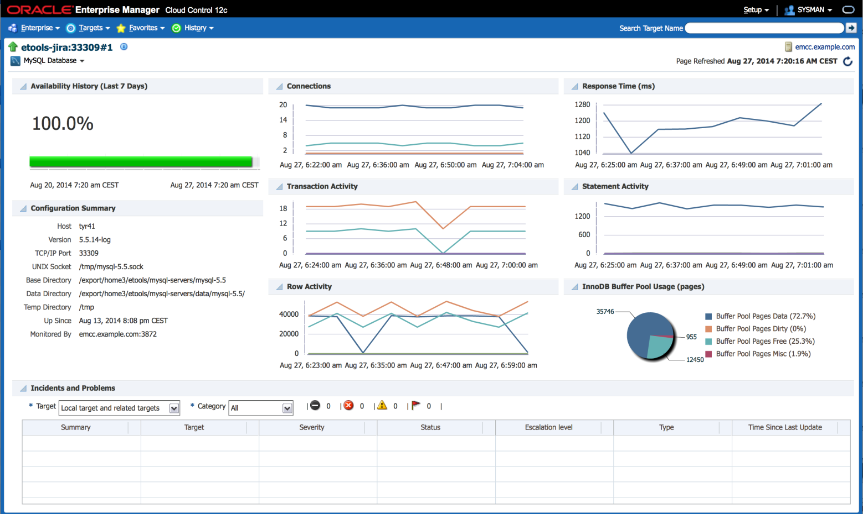
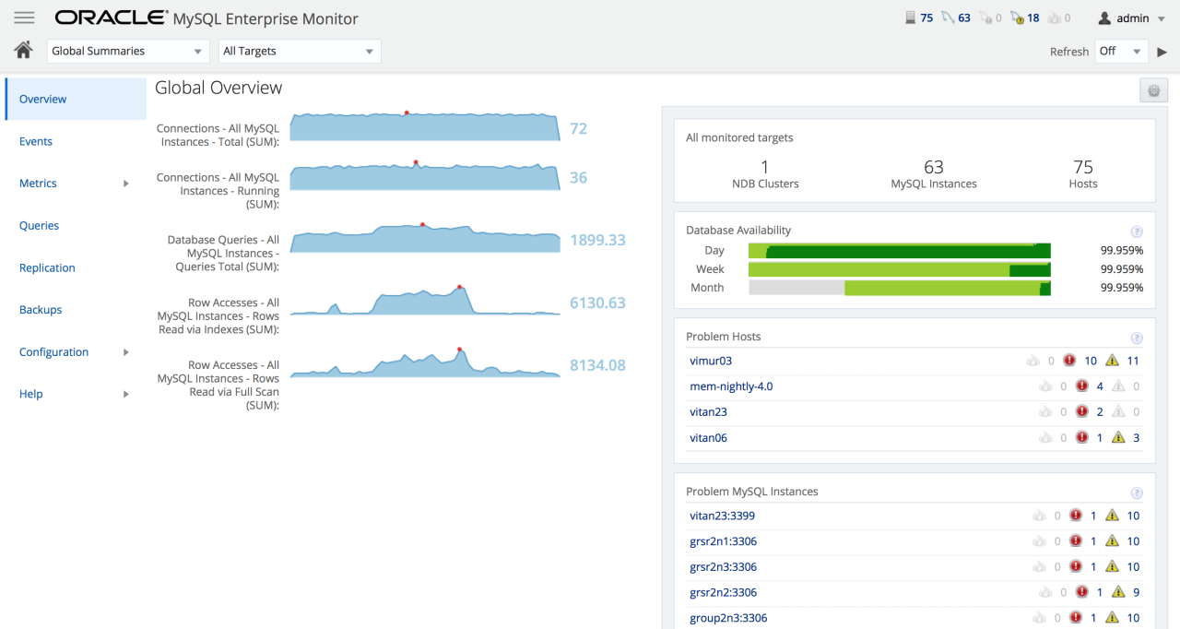
InnoDB Cluster
Monitoring
Oracle Enterprise Manager Plugin for MySQL
Availability and Performance monitoring
Configuration monitoring
Queries information
Performance and configuration metrics
Compliance Framework
Metric Extension included
MySQL Enterprise Monitor
Availability and Performance monitoring
Queries information
Performance and configuration metrics
MySQL Monitoring
Observabilité avancée : corrélation des traces, métriques et logs

Slide 47

Demonstration

Slide 48




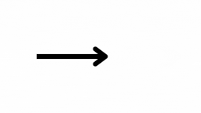
Demonstration infrastructure
ecommerce
Lan : 10.87.x.x
DC 2
mysql-instance-1
mysql-instance-2
mysql-instance-2
mysql-router-1
Primary
Secondary
Secondary
msql01-demo

Slide 49
Demonstration scénario
ecommerce
Lan : 10.87.x.x
DC 2
mysql-instance-1
mysql-instance-2
mysql-instance-2
mysql-router-1
Primary
Secondary
Secondary
Secondary
msql01-demo

Slide 50


Slide 51

Key takeaways

Slide 52
Resources
Editions
https://www.mysql.com/products/
Reference Manual
https://dev.mysql.com/doc/refman/9.4/en/
Pre-Checking Instance Configuration for InnoDB Cluster Usage
https://dev.mysql.com/doc/mysql-shell/9.4/en/check-instance-configuration.html
InnoDB Cluster
https://dev.mysql.com/doc/mysql-shell/9.4/en/mysql-innodb-cluster.html
Replication Sets
https://dev.mysql.com/doc/mysql-shell/9.4/en/mysql-innodb-replicaset.html
MysQL Diagnostic Information
https://dev.mysql.com/doc/mysql-shell/9.4/en/mysql-shell-utilities-debug-diagnostics.html

Slide 53

Thank you
Emmanuel COLUSSI
emmanuel.colussi@oracle.com

